Slide 1
Ambulance Detection
DIP Mini Project

Slide 2
MOTIVATOR

Slide 3
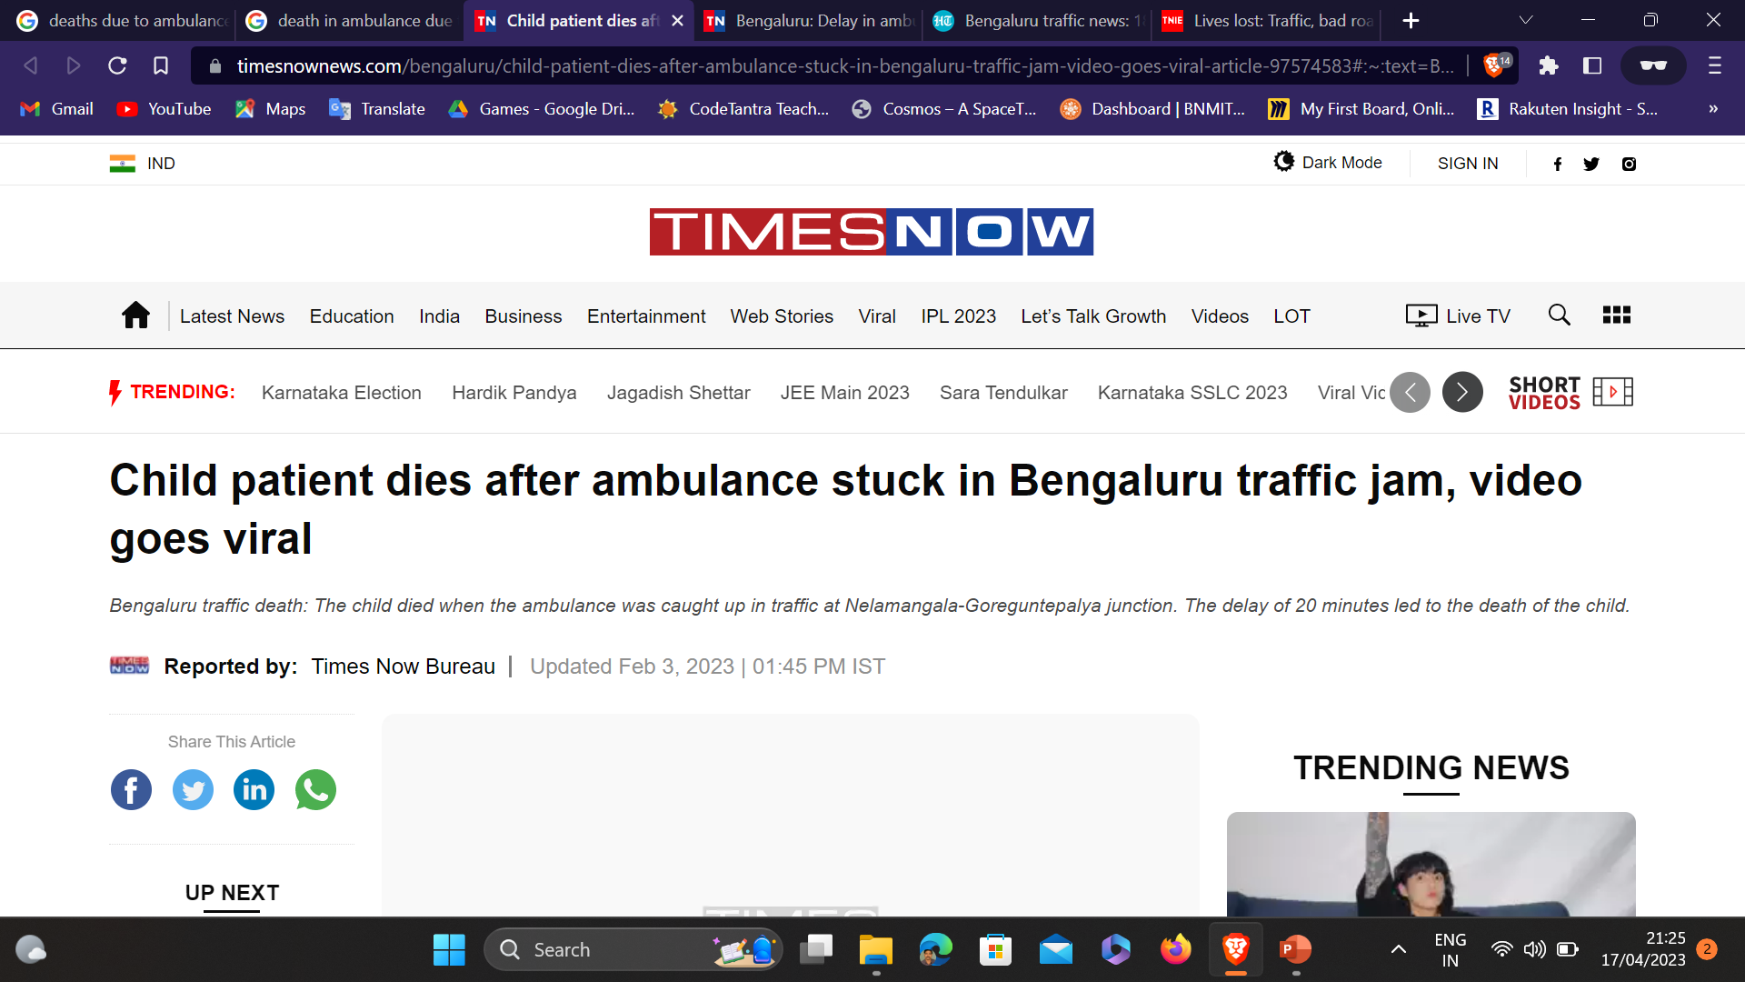
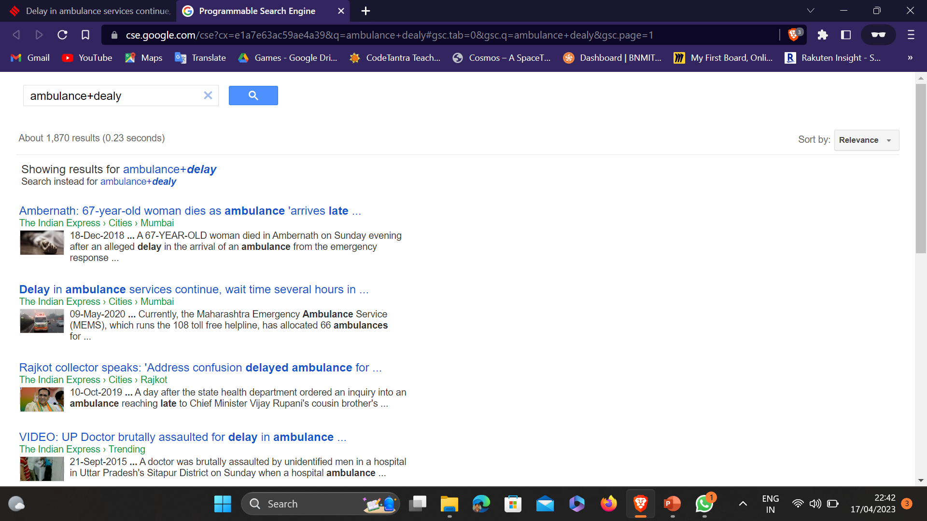
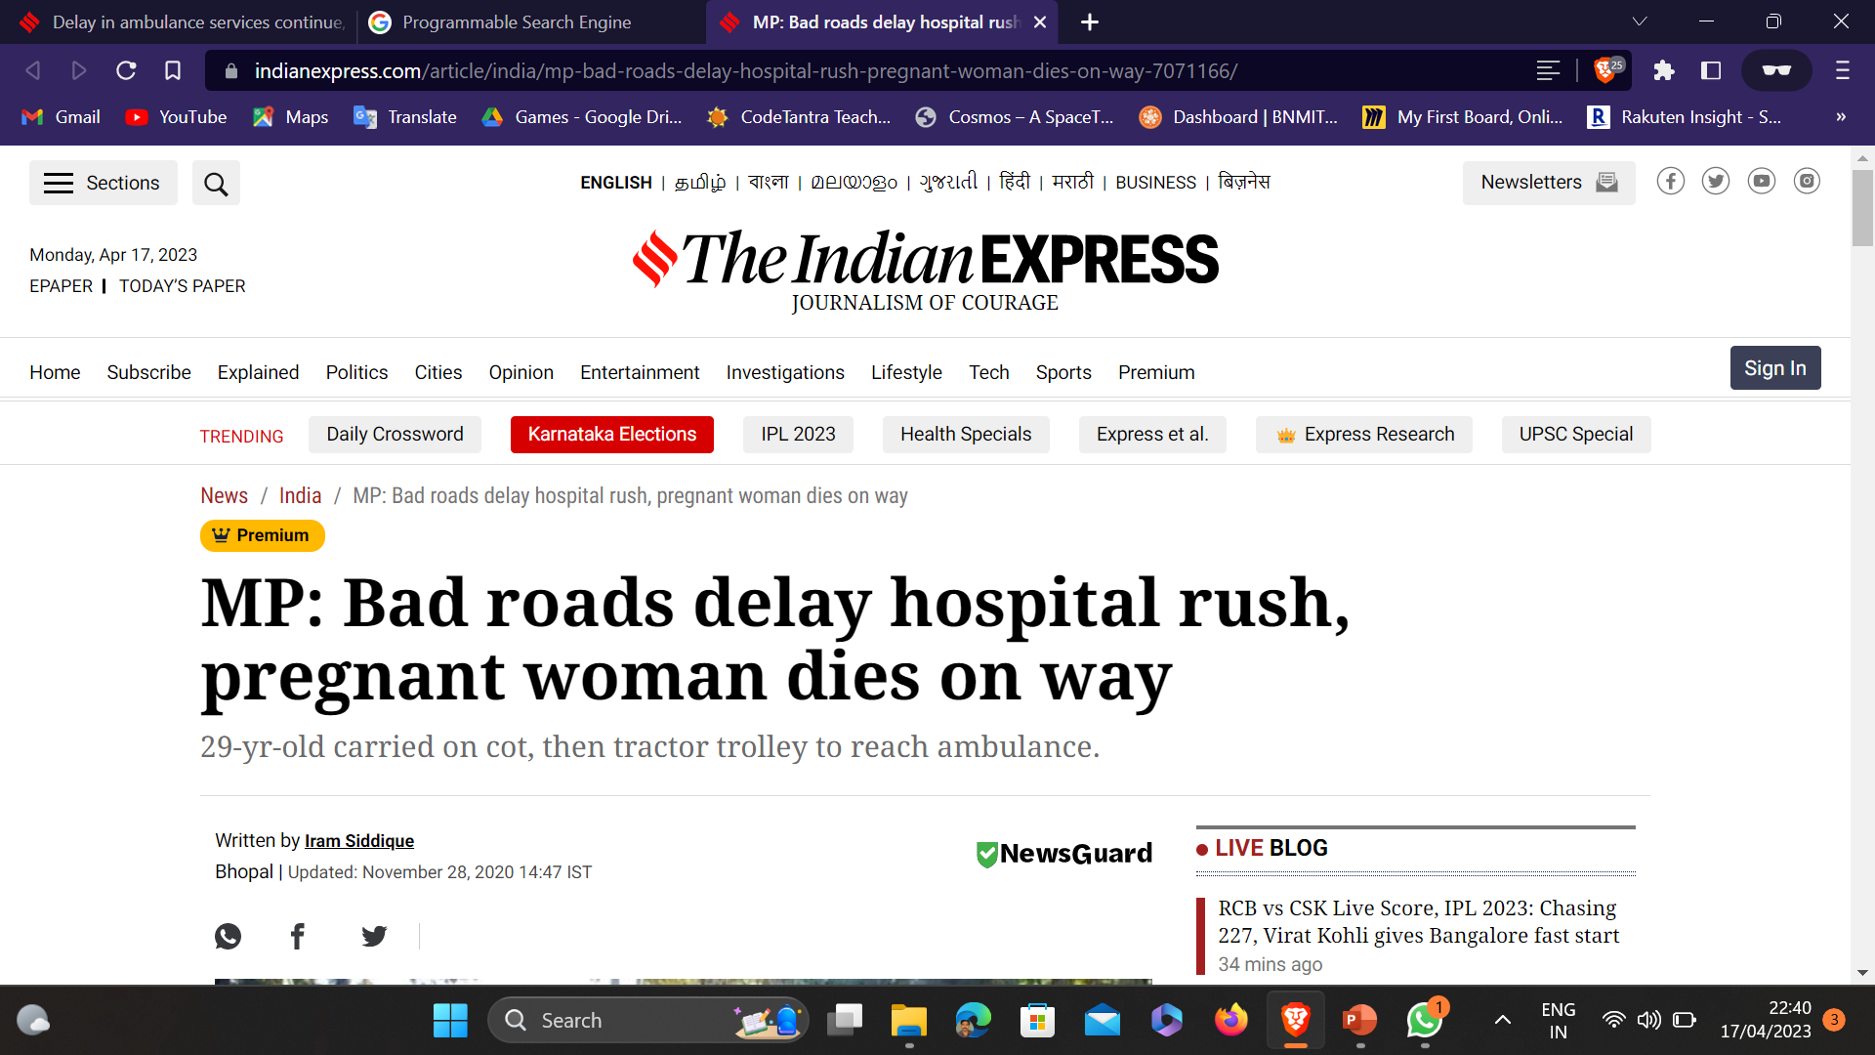
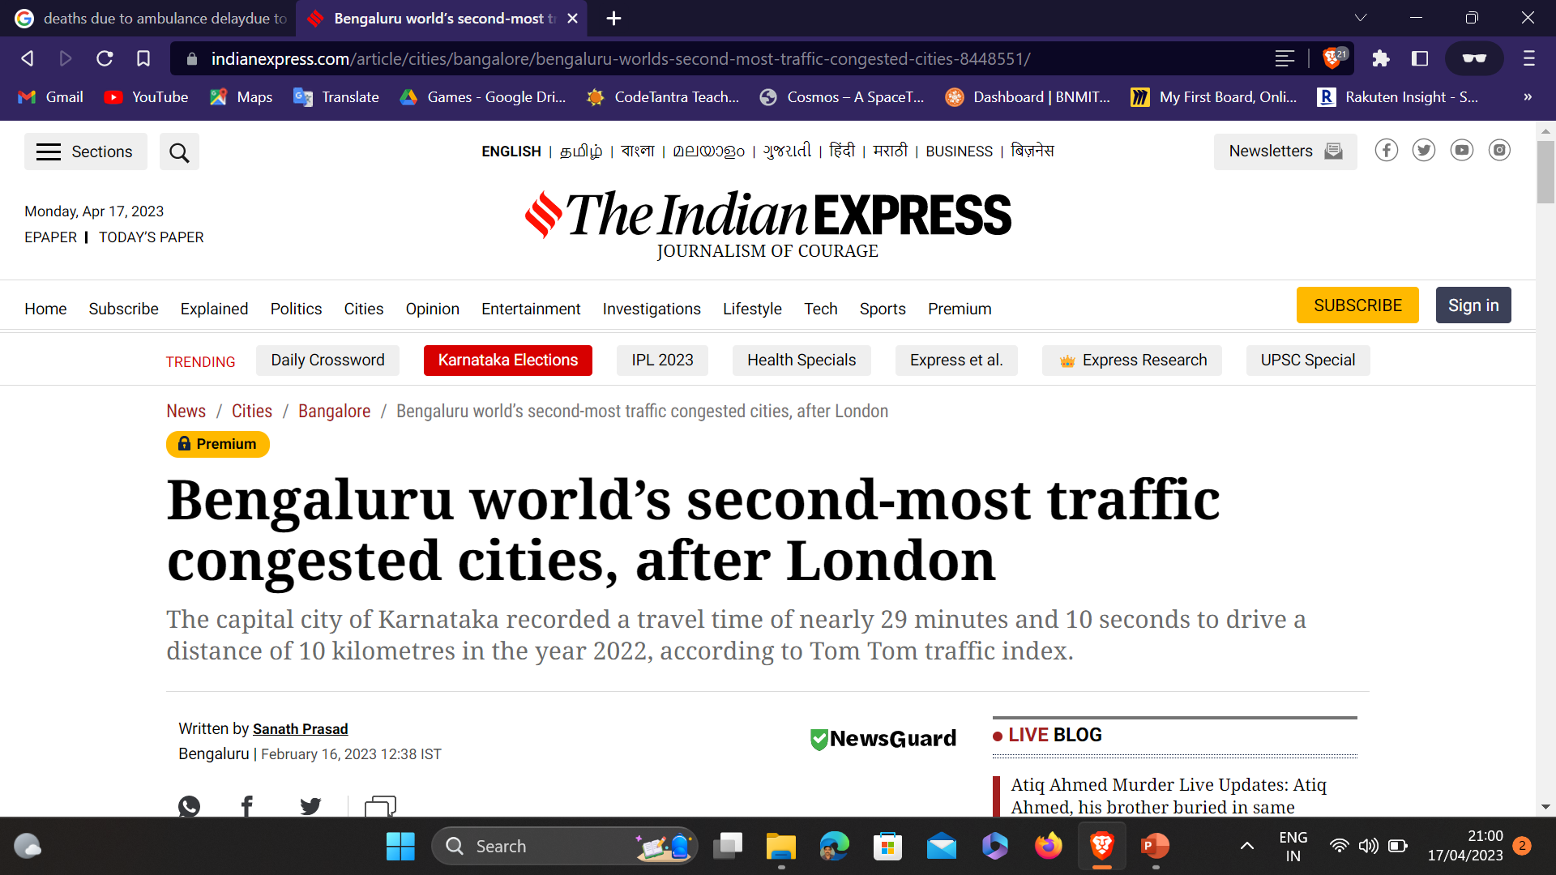
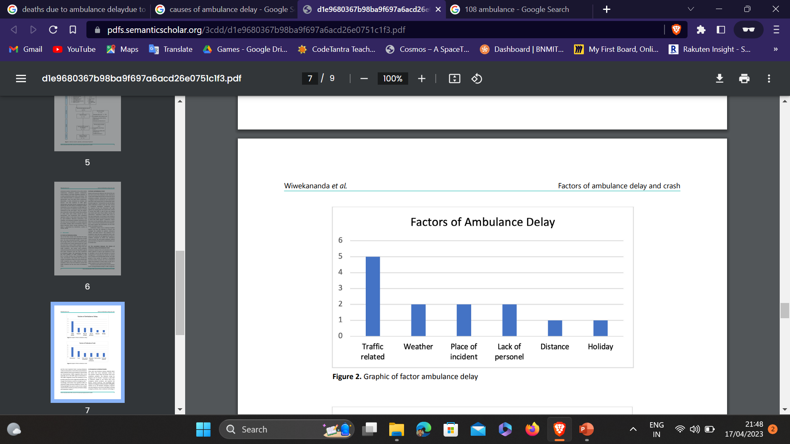
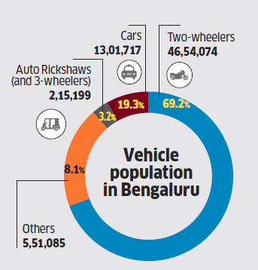
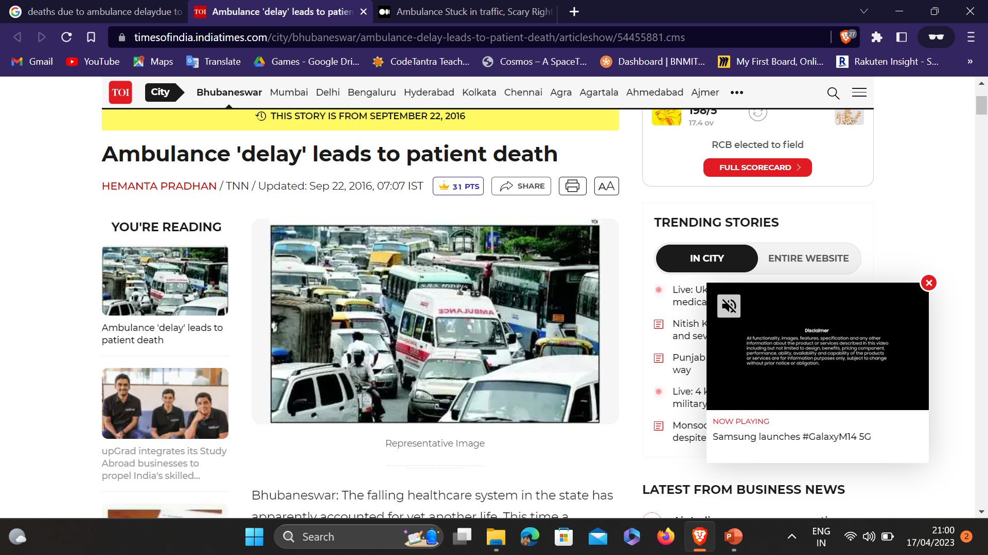
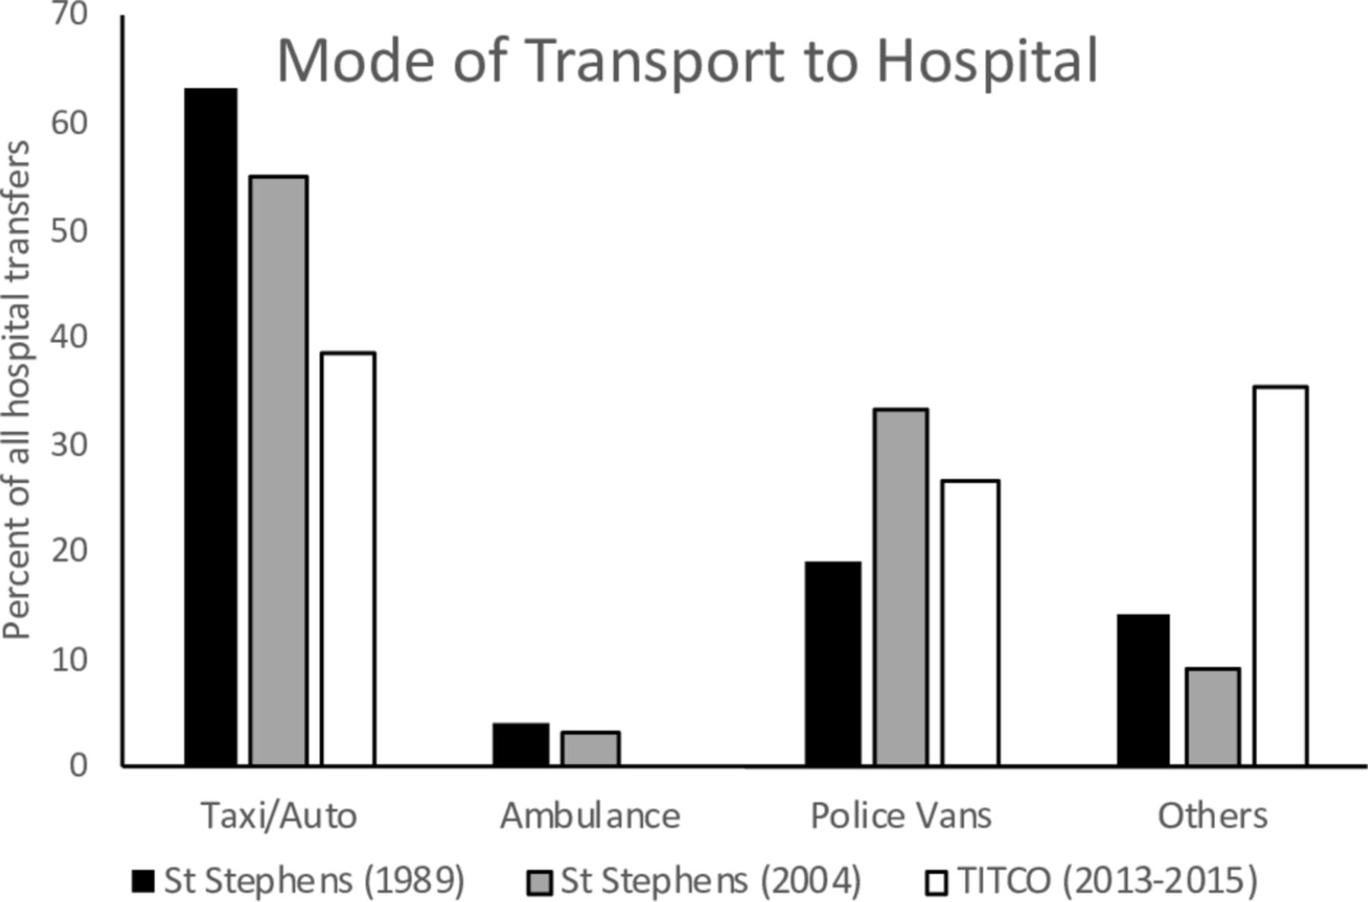
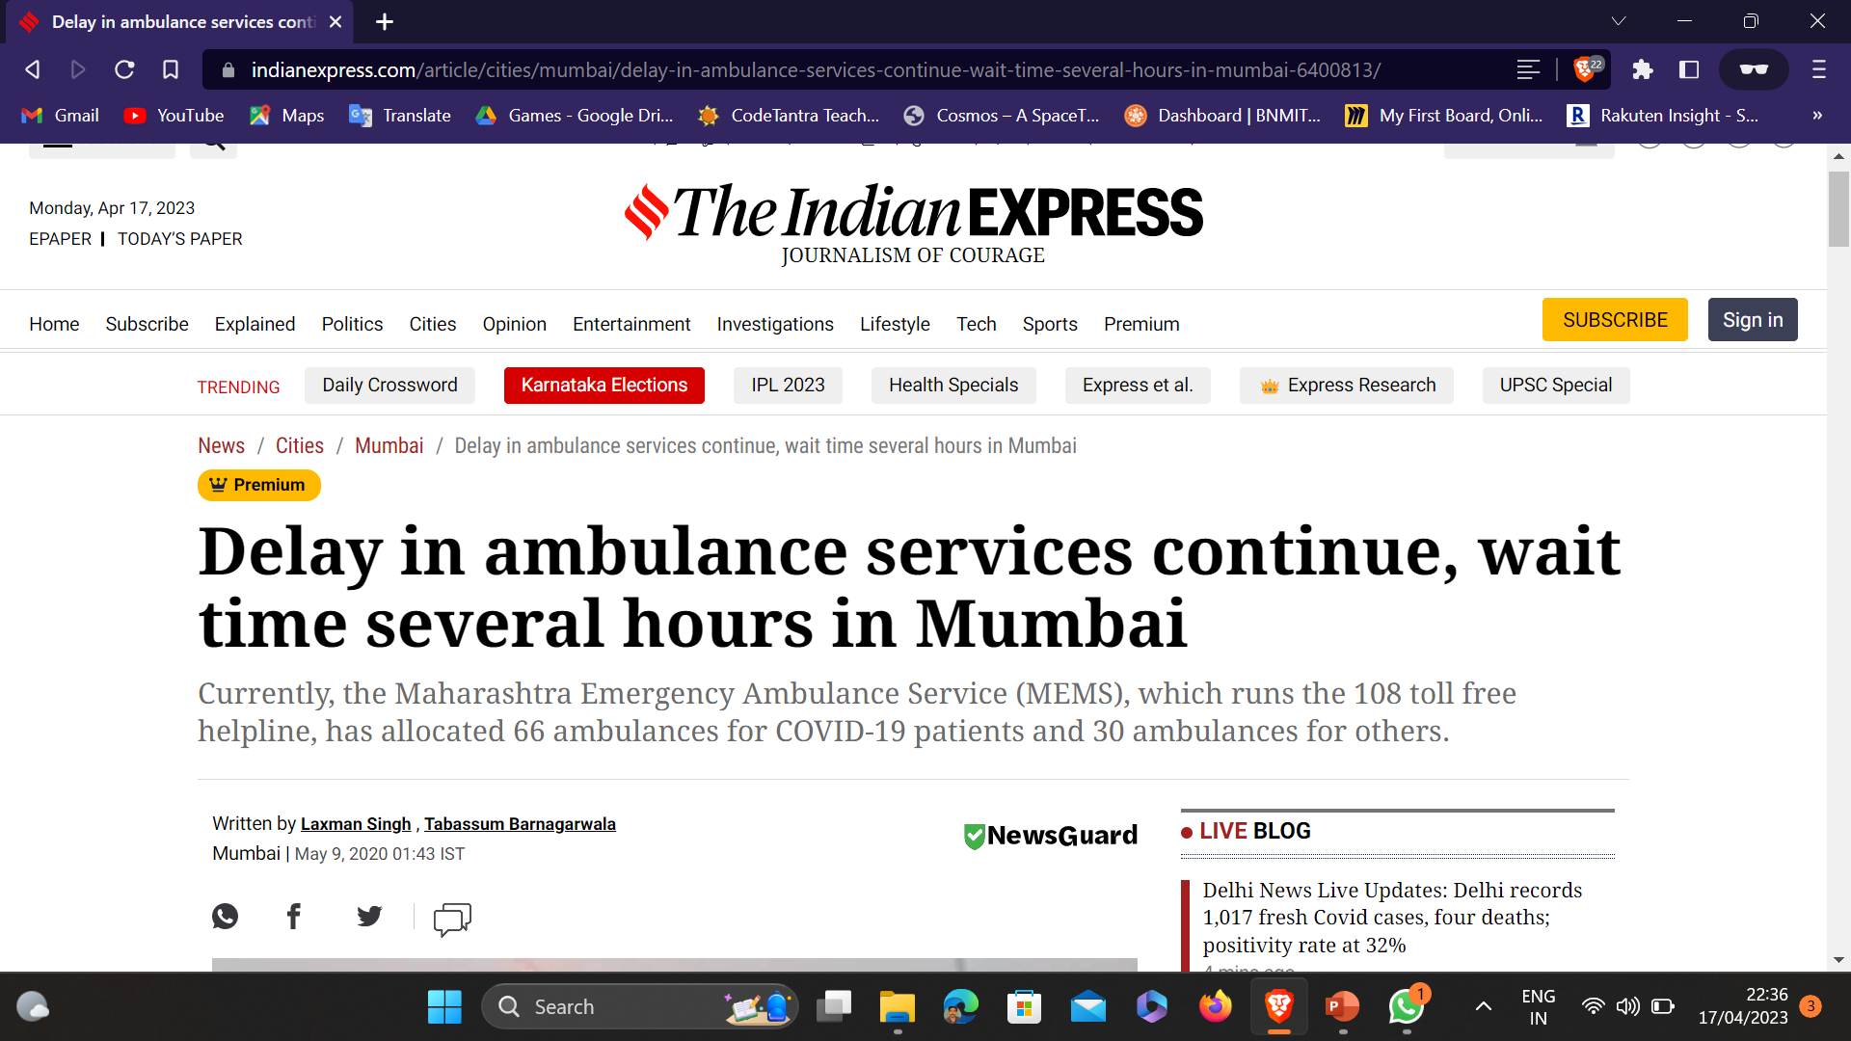
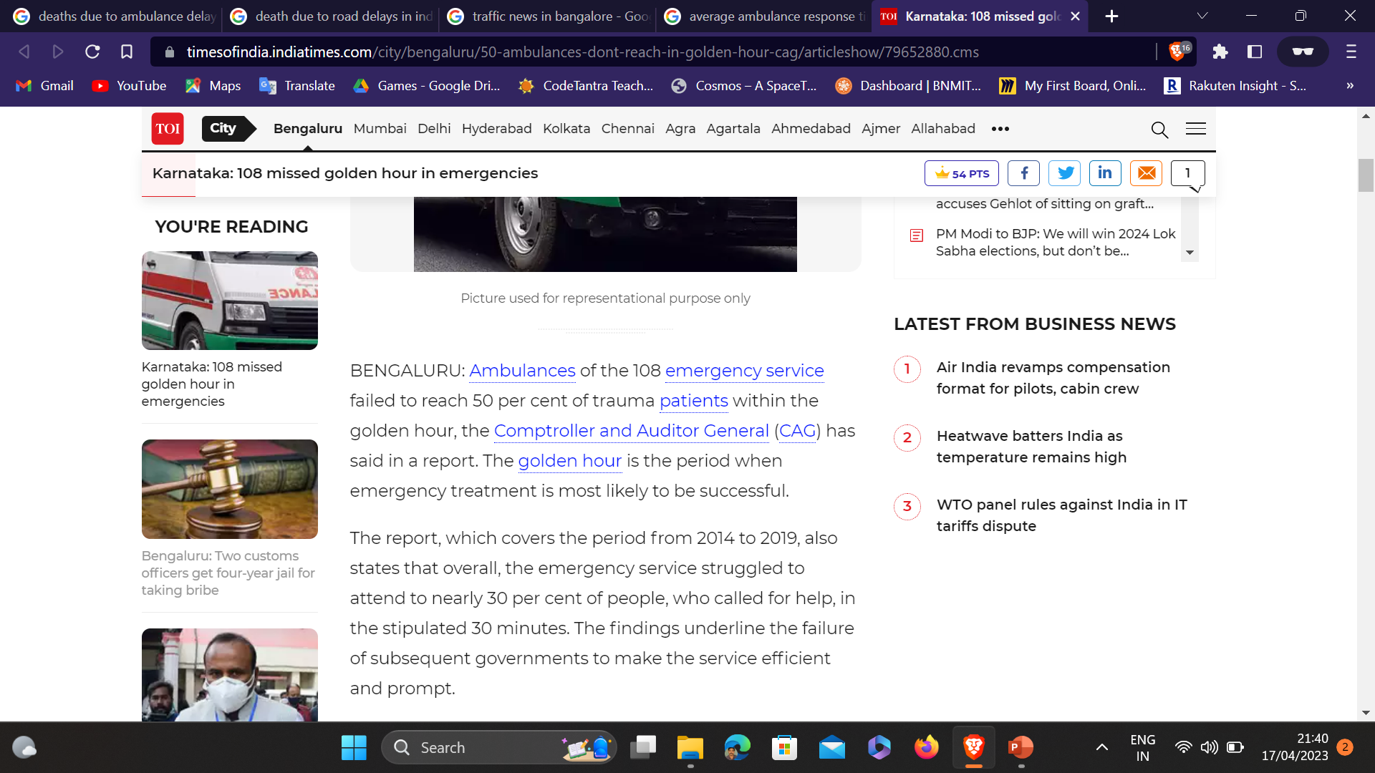
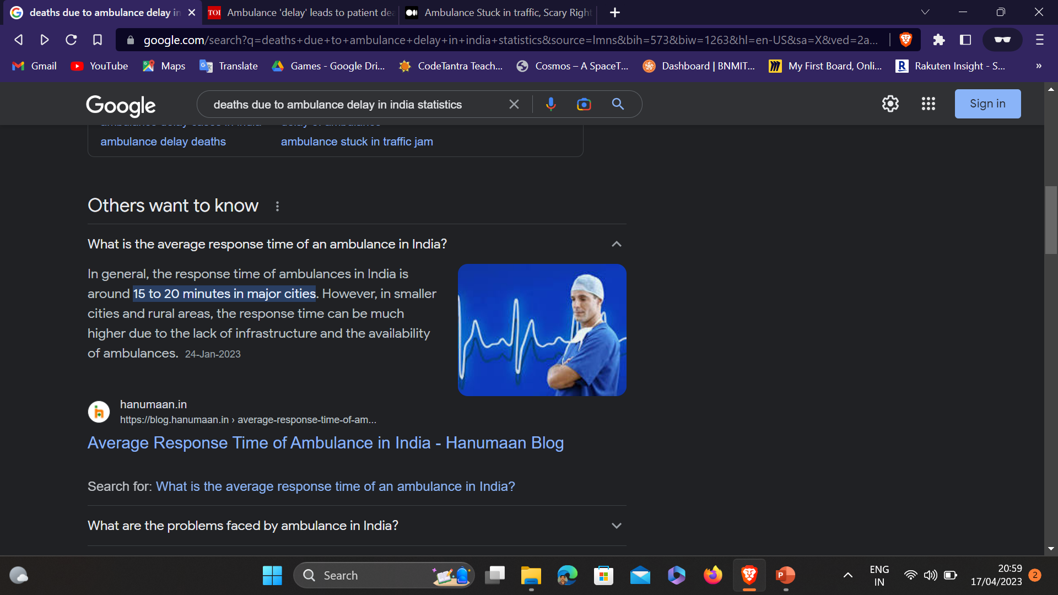
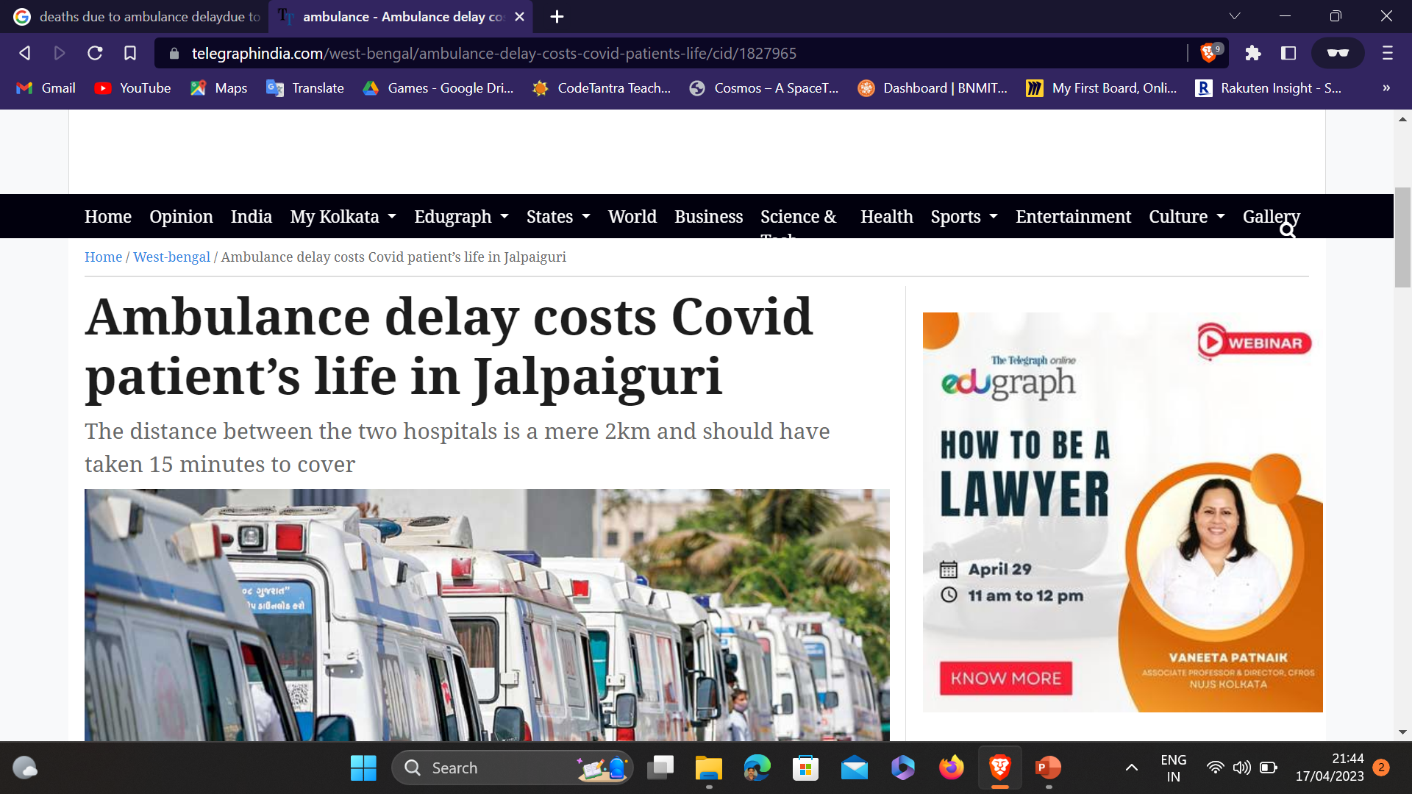
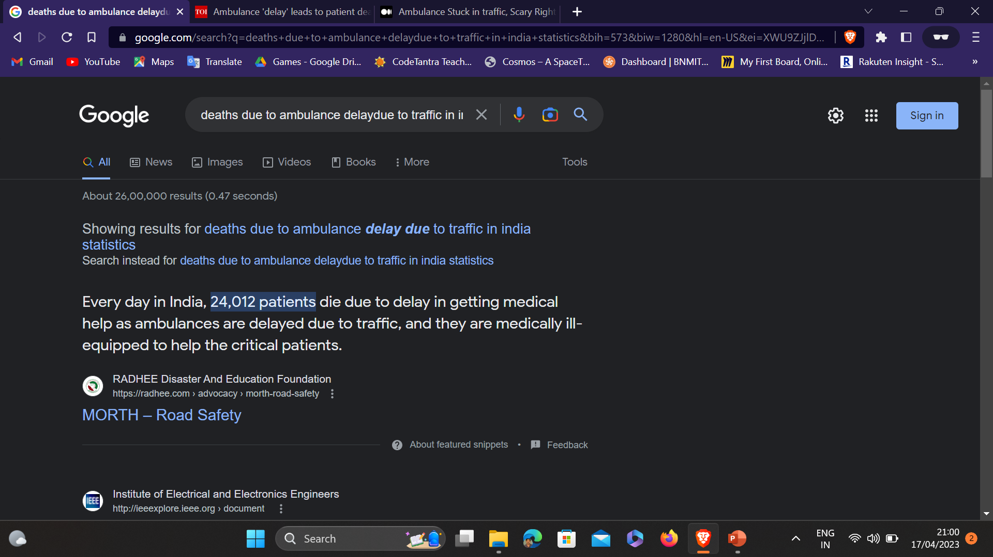


Slide 4
INTRODUCTION
Recognition of AMBULANCE in traffic

Slide 5
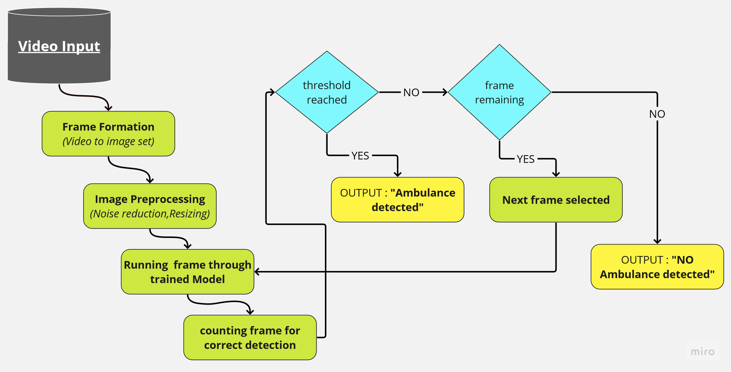
Step 1: Video Capture: To capture video from a specified source, the code makes use of the VideoCapture function in the OpenCV package. The source might be a live camera stream or a video file (such as MP4, AVI). The following step is to employ a loop to read the video's frames one by one using the cap.read() method.
Step 2: Resizing: To match the input dimensions required by the Keras Sequential model, the frames are shrunk using the cv2.resize function. The frames are downsized to 224x224 pixels in the given code. Resizing the frames guarantees that the deep learning model's input size is consistent.
Step 3: Predicting: The resized frame is then sent to the predict_class function, which loads and infers the pre-trained Keras Sequential model (keras_model.h5) on the frame. The model is used by the function to forecast the likelihood of the frame containing an ambulance. The proposed model extracts characteristics from images by employing a sequence of convolutional layers.
Step 4: Threshold value: A threshold value is set to determine if an ambulance is detected in the frame. Visualization: If an ambulance is detected in a frame, the counter is incremented, and when this number reaches six consecutive detections, the frame with the detected ambulance is saved as ambulance.jpg. Additionally, the ambulance image is displayed in a window called "found" using the cv2.imshow function. Every frame of the video is subjected to the aforementioned stages till the programme is shut down.

Slide 6
Journal Paper

Slide 7
Open PDF

Slide 8
Runnable

Slide 9
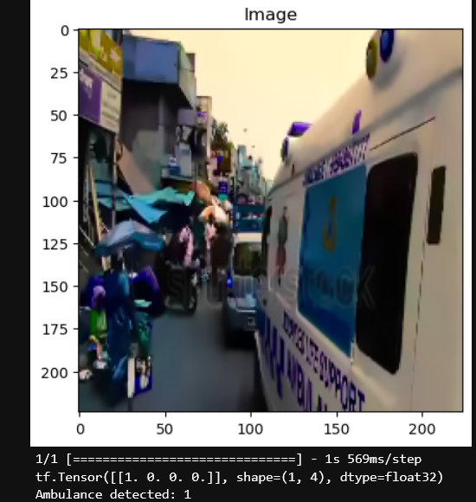
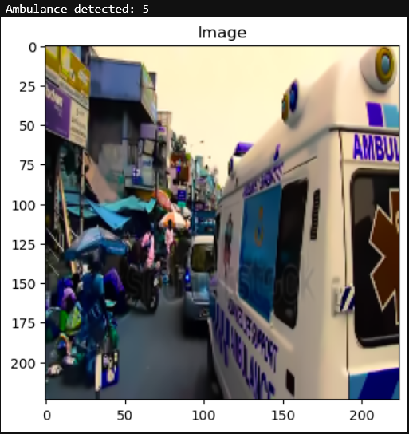
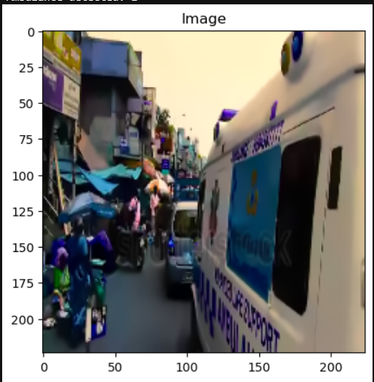
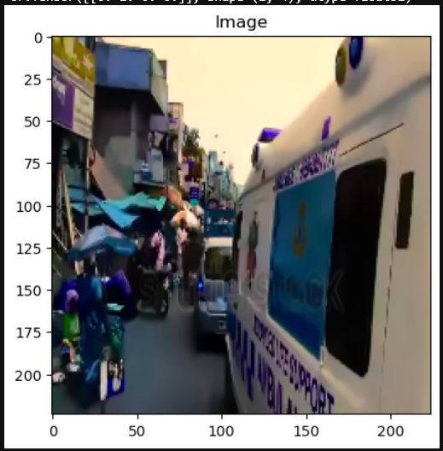
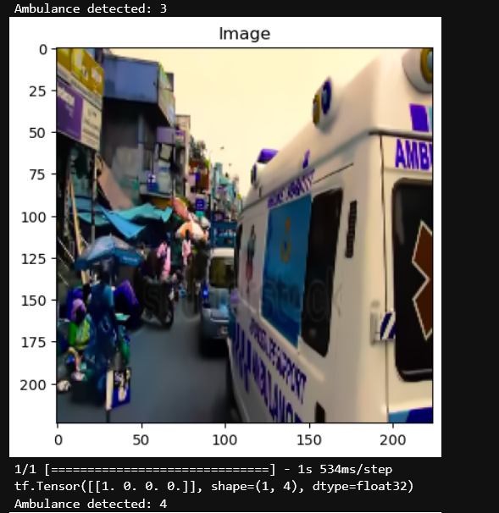
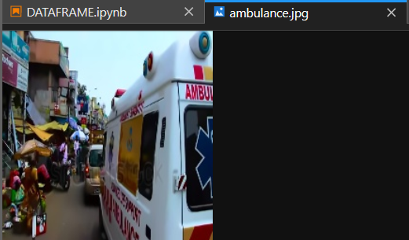

Slide 10
Gaps Identified

Slide 11
Srno. | Gaps identified
1. | Depends on the capability the cctv or camera installed. (Night vision, camera image quality, distance covered in view)
2. | Performance and accuracy issue as the model has to work spontaneously.
3. | How many parameters to be satisfied or fulfilled for correct analysis of desired object?
4. | Dataset used is not sufficient to train or is inappropriate according to country used in for.
5. | Not using the best frame analysis algorithm to get the better input thus increasing workload.

Slide 12
Shukriya

